Slide 1


Slide 2

ICT ROADSHOW 2026
Enterprise & Applications
Section
Driving Digital Transformation Across the University
ICT Department | iYunivesithi Walter Sisulu

Slide 3





OUR FOCUS AREAS
Five Pillars of Enterprise & Applications
Everything this section delivers sits under one of five pillars — from the ERP core, to learning systems, to how we build, analyse and license software.
ERP
LMS
Software Development
Business Analysis
Software Licensing
Core systems for Student, HR, Finance & Assets.
Digital learning & assessment platforms.
DevSecOps build, integration & support.
Requirements, mapping & solution design.
Governance of licensed platforms.
Driving Digital Transformation Across the University
ICT Roadshow 2026

Slide 4





IN EVERYDAY USE
Systems Our Community Uses Every Day
WALE
Moodle LMS
MyWSU App
App Yard
Service Desk
WSU Digital Assistant — AI chatbot for student & staff support.
Online learning, course content & examinations.
Timetable, results, registration & notifications.
Central hub linking staff & student digital services.
Log and track ICT & facilities support tickets.
Driving Digital Transformation Across the University
ICT Roadshow 2026

Slide 5










ROADSHOW DEMONSTRATIONS
Mobile Applications to Showcase
MyWSU Mobile Application
★★★★★
Wale — WSU Digital Assistant
★★★★★
Student login, timetable, results, registration, notifications, academic information & services.
AI chatbot for student/staff questions, guided support & service requests.
WSU Service Desk App
★★★★★
Residence / RASA App
★★★★☆
Report ICT/facilities incidents, attach photos/voice, track tickets, notifications.
Report residence faults & maintenance issues, routing to Facilities, tracking.
Student Affairs App
★★★★☆
Invigilator App
★★★★☆
Student-life cases, bookings, counselling, activities, residence-life support.
Exam authentication, student verification, camera/audio checks, exam monitoring.
Graduation / Event Ticketing
★★★☆☆
BrandShop / Campus Marketplace
★★★☆☆
QR tickets, verification, attendance & event management.
University merchandise, catalogue, stock, reservations & orders.
Campus Notifications App
★★★☆☆
Staff / Internal Services App
★★★☆☆
Push notifications, emergency announcements, targeted communication.
Staff requests, approvals, service access & notifications.
Driving Digital Transformation Across the University
ICT Roadshow 2026

Slide 6







ERP
ERP: Systems & Management
Student Systems
Finance Systems
HR Payroll
Assets & Space
Academic Admin, Exams & Graduations, Residence, Bursaries & Loans
General Ledger, Accounts Receivable, Procurement & Supply Chain
Appointments, Leave / iEnabler, Personnel & Payroll Systems
Asset System, Access Control, Space System, Batch Reports
Modernisation
Access Governance
Testing & QA
User Access Groups
Change management, upgrades & continuous improvement
Granting, modifying & revoking user permissions securely
Validates changes and upgrades before go-live
Forum aligning ICT & departments on ERP governance
Driving Digital Transformation Across the University
ICT Roadshow 2026

Slide 7





SOLUTION AREAS
Where Our Applications Make an Impact
Research & Innovation
Student Success & Support
Governance & Wellbeing
Administration & Operations
Enterprise Integration
Ethical Clearance System
Graduate Employability Portal
Contracts Management System
Service Desk Application
WiseUp Integration Panel
External Examiners System
Graduation Tickets
Facilities Management System
Venue & Chair Booking Systems
Library Migration: Vital to D-Space
Conference Management (HEQAF, SAAIR & more)
Mobile Application
Union Membership System
Transport & Supply Chain Tools
Project Management System
Postgraduate Tracking
WALE Chatbot
My Safe Space Case Management
HR Skills Development System
Entrepreneurship Measuring Tool
Driving Digital Transformation Across the University
ICT Roadshow 2026

Slide 8







LMS · SOFTWARE LICENSING
Learning Platforms & Licensed Applications
LEARNING & DIGITAL ASSESSMENT
LICENSED RESEARCH & BUSINESS APPLICATIONS
Moodle Examination Integration
MATLAB
Connects Moodle LMS with exams for online delivery.
Algorithm development, data analysis & modelling.
Online Assessment Tool
Converis System
Digital test & assessment delivery outside the LMS.
Researcher profiles, outputs & academic CVs.
EduPlacer
Covidence
Digital placement & learning-support tool.
Organise & review publications for literature studies.
Sinawe for DLT
REDCap
Supports Distance Learning & Teaching initiatives.
Secure surveys and databases — used by FMHS.
Driving Digital Transformation Across the University
ICT Roadshow 2026

Slide 9
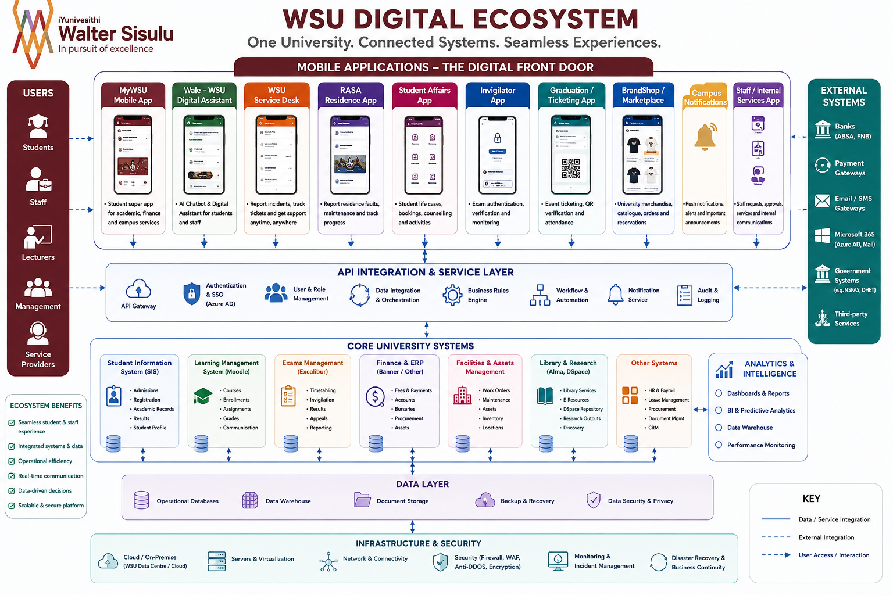
Driving Digital Transformation Across the University
ICT Roadshow 2026

Slide 10



WHO WE ARE
Our Team
Mr M. Magewu
Mr S. Gegana
Mr T. Bidie
Deputy Director: Enterprise & Applications
Manager: ERP Systems
ERP Support Specialist
Mr H. Mgazi
Ms N. Philiso
Ms L. Mabengwana-Jack
Database Administrator & Developer
Developer
Business Analyst
Driving Digital Transformation Across the University
ICT Roadshow 2026

Slide 11
THANK YOU
Questions & Discussion
Enterprise & Applications Section · ICT Department · iYunivesithi Walter Sisulu

